Slide 1


HP CASE STUDY
ROUND 2
ATMAN AINAPURE
ATMANAINAPURE@GMAIL.COM

Slide 2
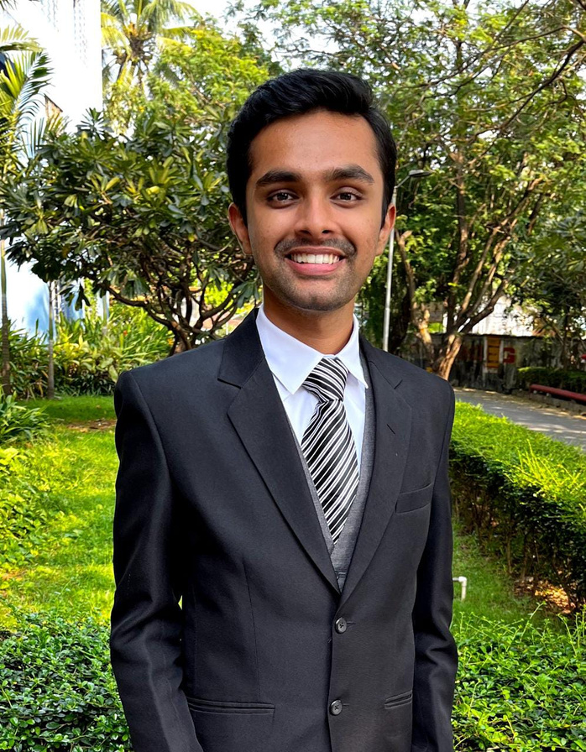

ABOUT ME
Name: Atman Ainapure
College: Sardar Patel Institute of Technology, Mumbai.
Education stream: B.tech Computer Engineering
Email: atmanainapure@gmail.com
A Glimpse into My College Life
CGPA: 9.44 (fifth in class)
Winner of the Barclays Data Stellar Hackathon, 2023.
Recognized as the national winner at the "Break the Barrier" Hackathon, 2022.
President of the Rotaract Club of S.P.I.T. (community based club)

Slide 3

BACKGROUND AND OVERVIEW
In just 32 hours following the completion of my exams on May 29th, I embarked on this ambitious journey. Initially, I utilized Apify, Facebook Page Scraper, and Octoparser to extract data from various social media platforms. However, due to limitations with the Facebook API and Twitter scraping, I swiftly adapted my approach and successfully collected comprehensive data from Amazon and Flipkart instead. Through efficient automation using Power Automate, I acquired and organized information on HP laptops, printers, desktops, ink, and accessories, which I then meticulously cleaned and subjected to sentiment analysis. The culmination of these efforts resulted in the creation of a comprehensive knowledge graph that shed light on consumer perceptions and market trends.

Slide 4
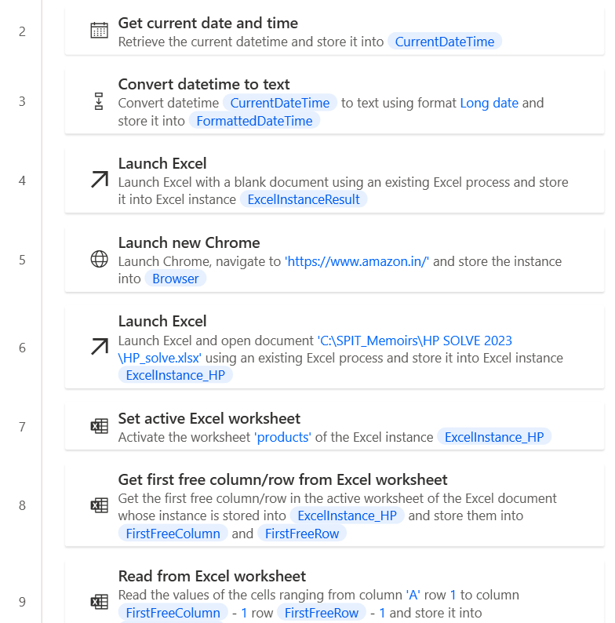
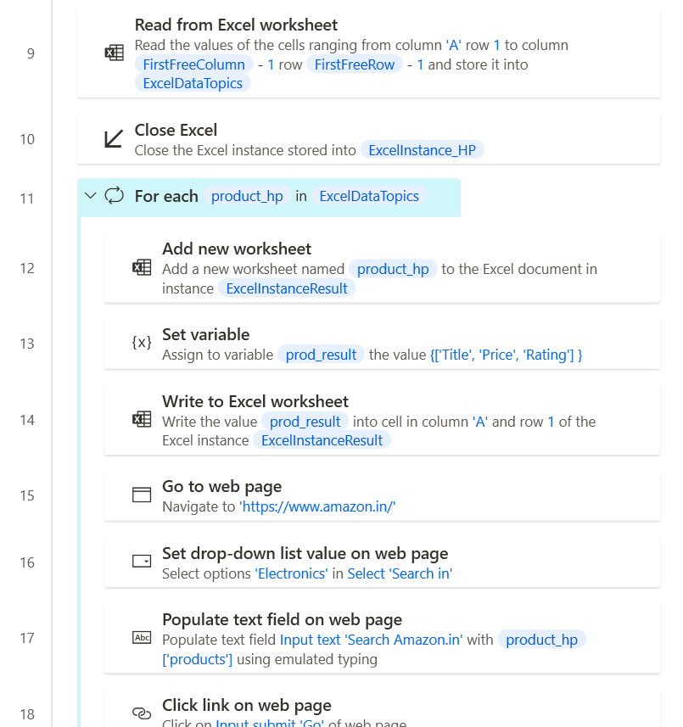
Scraping all the data from amazon and flipkart

Slide 5
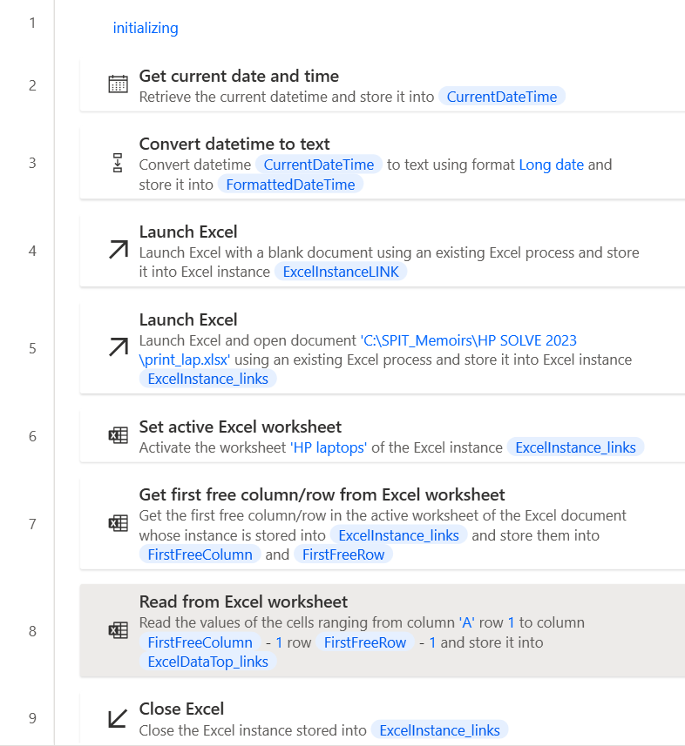
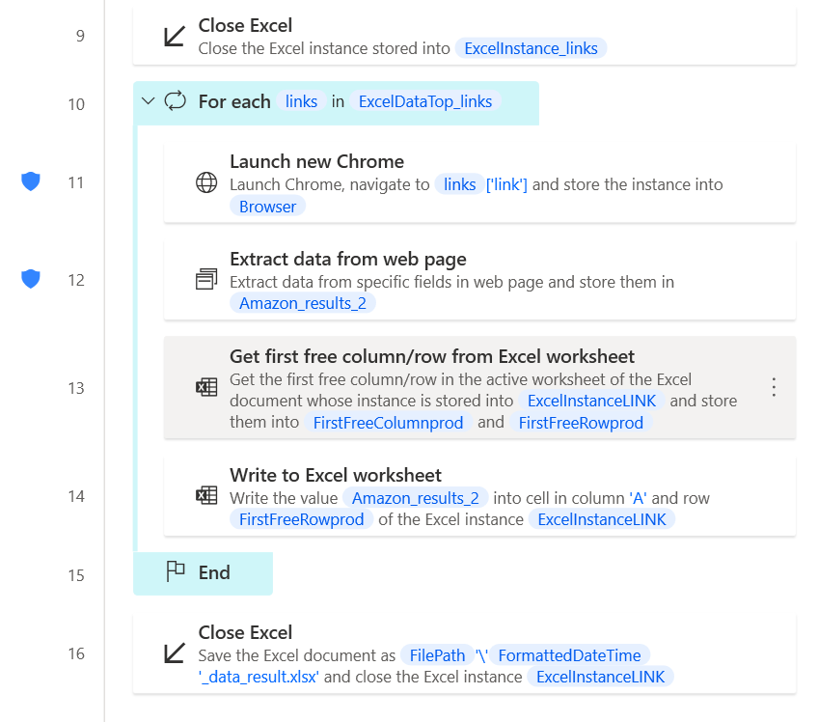
2. Scraping the links, reviews and relevant information

Slide 6
My thought process during web scraping
In this project, I leveraged the power of Power Automate, a preinstalled tool in Windows 11, to streamline the data acquisition process without any additional overhead. Through web scraping, I collected a comprehensive set of links for HP laptops, printers, desktops, and other relevant products. Extracted information:
Extracted ratings and evaluated the basis on which customers assigned them, providing insights into product quality and customer satisfaction.
Gathered information on the specific features or qualities that the products are known for.
Acquired rankings of the products in the electronics category.
Determined the rankings of the products specifically within the laptops category, enabling a more focused analysis of their performance within this segment.
Extracted reviews and utilized keywords to perform sentiment analysis, revealing customer opinions and sentiments towards the products.

Slide 7
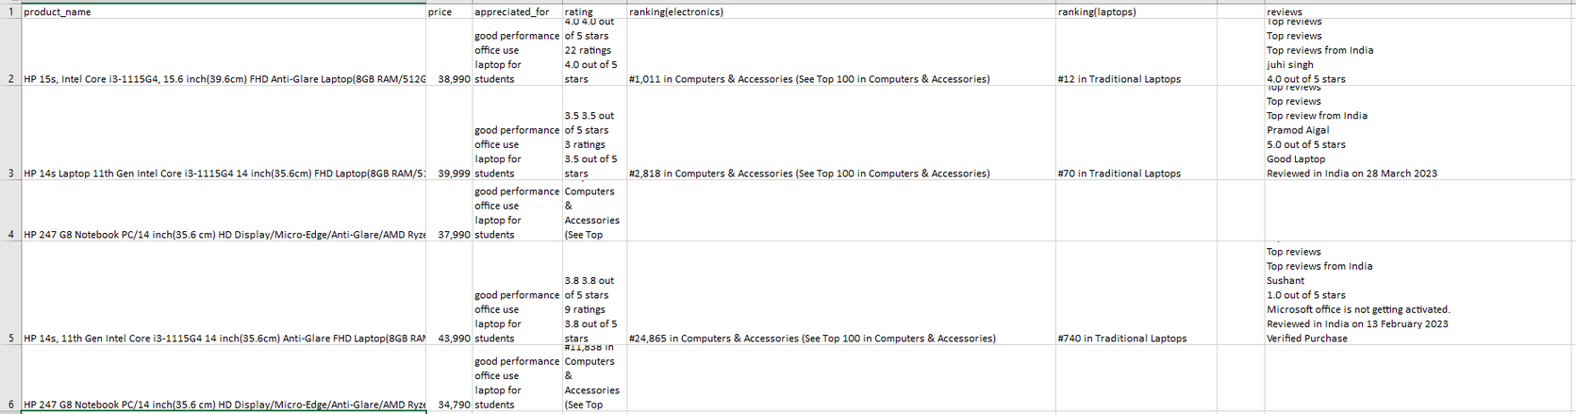
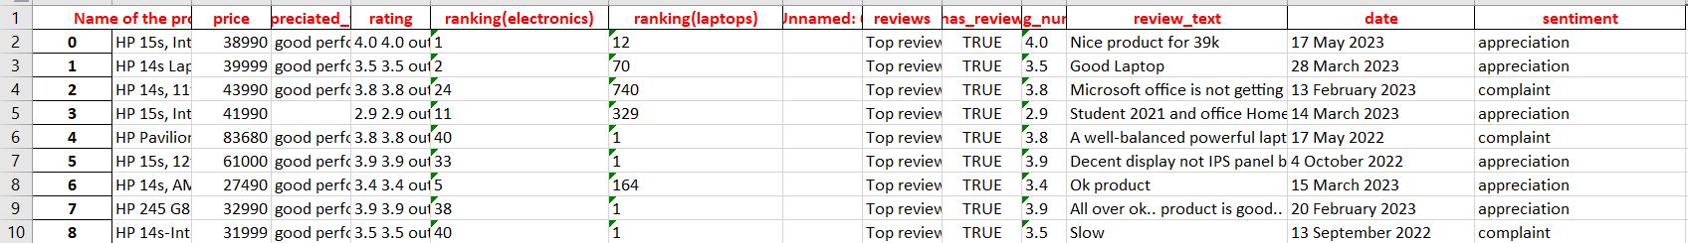
3. Cleaned the data using python script and used sentiment analysis
INPUT
OUTPUT

Slide 8
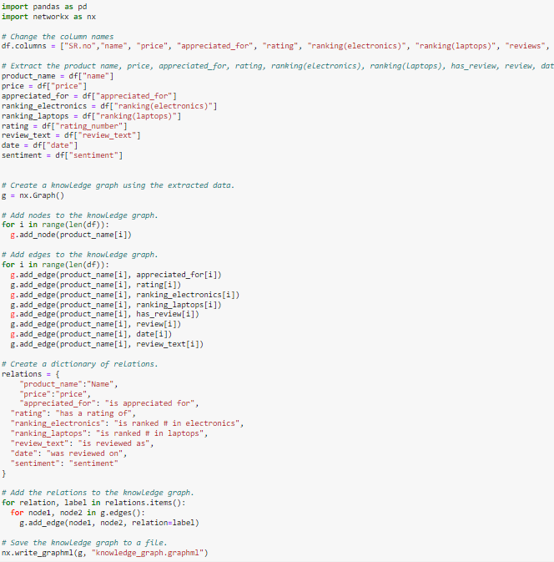
4. Python code to make a knowledge graph using networkx

Slide 9
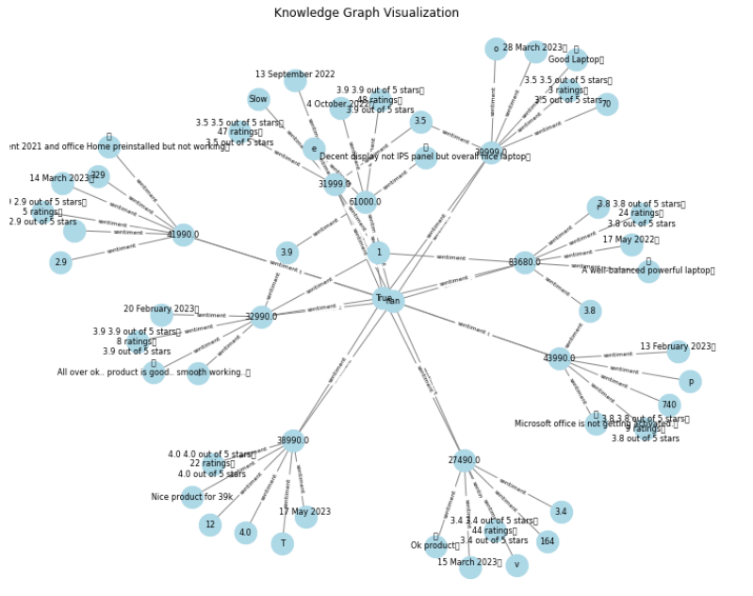
Output Knowledge graph

Slide 10

It provided me with a deep understanding of new techniques in web scraping and the practical applications of knowledge graphs. This experience has truly transformed my perspective, expanding my horizons and illuminating the vast potential of web scraping and knowledge graph use cases.

